Slide 1
Lecture 5
Benefits of Cloud Computing
Instructor : Engr. Tehmeed

Slide 2
Problems solved by the Cloud
Flexibility: change resource types when needed
Cost-Effectiveness: pay as you go, for what you use
Scalability: accommodate larger loads by making hardware stronger or adding additional nodes
Elasticity: ability to scale out and scale-in when needed
High-availability and fault-tolerance: build across data centers
Agility: rapidly develop, test and launch software applications

Slide 3
Infrastructure as a Service (IaaS)
Platform as a Service (PaaS)
Applications
Data Runtime Middleware O/S Virtualization
Software as a Service (SaaS)
Applications
Data Runtime Middleware O/S Virtualization
On-premises
Applications
Data Runtime Middleware O/S Virtualization
Applications
Data Runtime Middleware O/S Virtualization
Servers
Storage
Servers
Storage
Servers
Storage
Servers
Storage
Networking
Networking
Networking
Networking
Managed by you
Managed by others

Slide 4
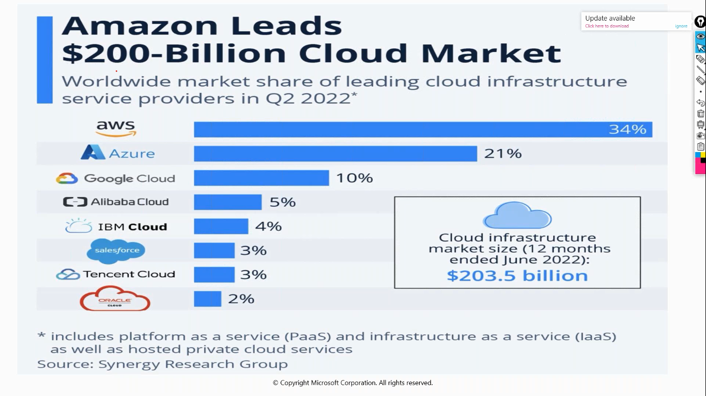

Slide 5
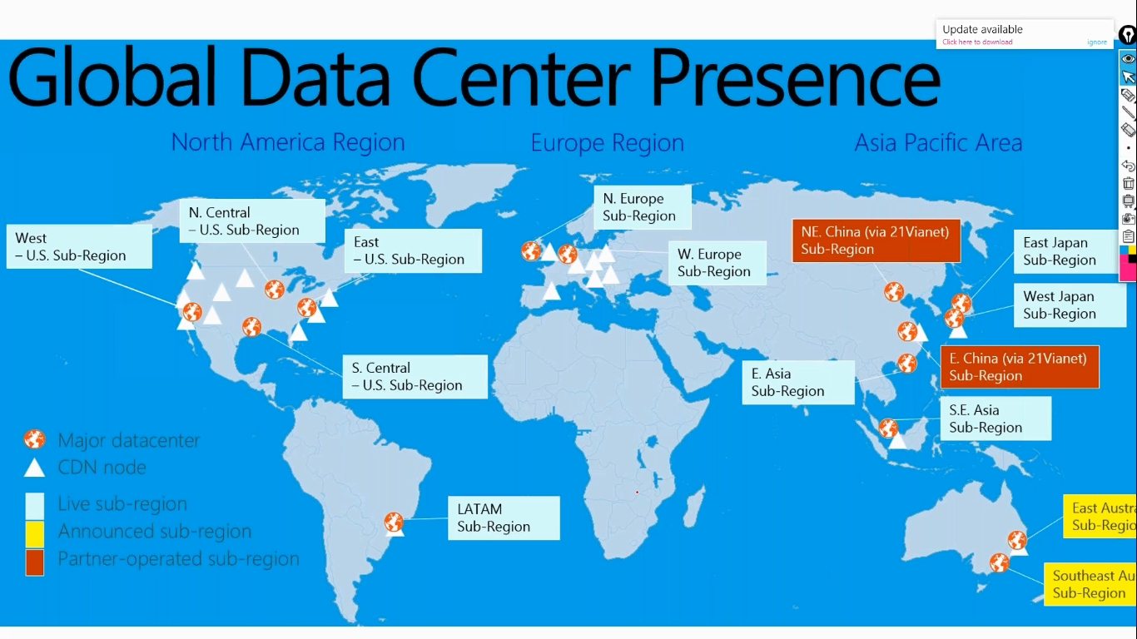

Slide 6

Any Questions ?

